Slide 1
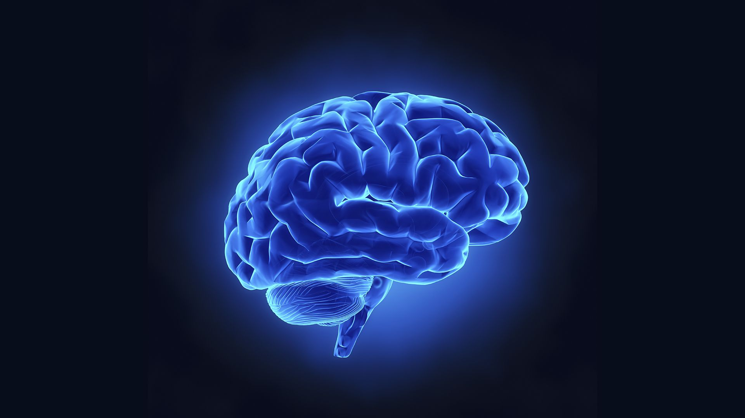
Brain Tumor Cells Detection using Image Processing Technique

Slide 2
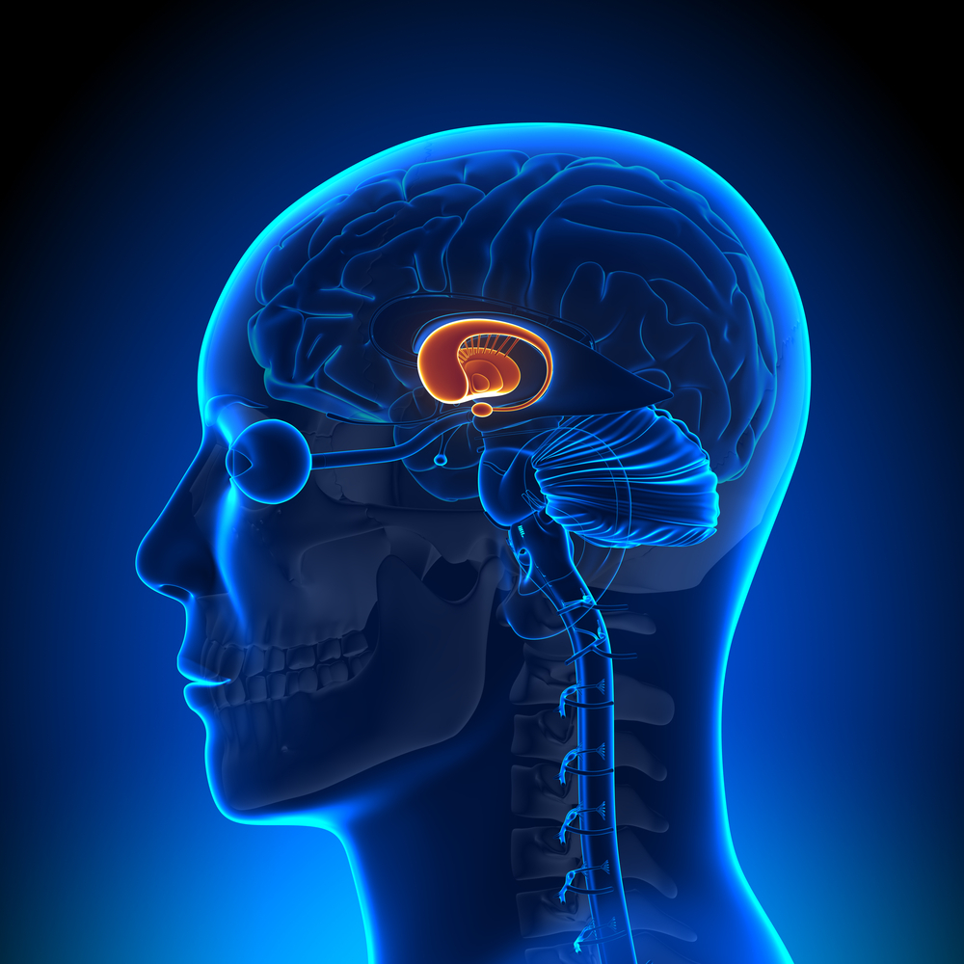
Contents:
Project Objective
Introduction
Literature Survey
Block Diagram
Implementation
Results & Discussion
Performance Analysis
Snapshots
Conclusion & Future Score

Slide 3
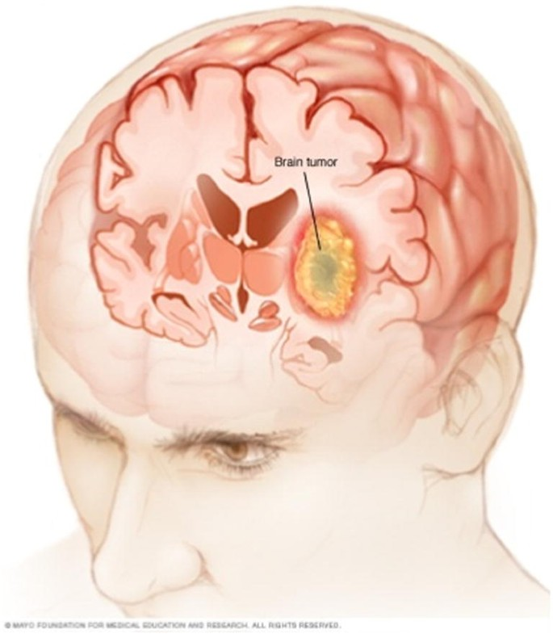
Project Objective:
The complete goal of the project can be divided into 3 sub goals:
The first goal is the processing of Magnetic Resource Imaging(MRI) scanned brain images using Watershed Algorithm & Edge Detection.
Once the image is processed, it is sent for the detection of the Brain Tumor.
The third goal is to classify the Tumor using CNN into the following types:
Benign Tumor
Meningiomas
Pituitary Adenomas
Malignant
Gliomas

Slide 4

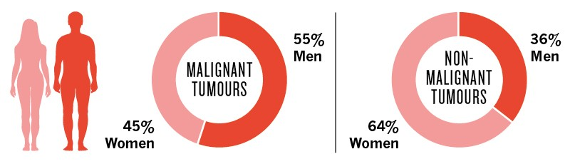
Introduction:
Brain is the major part which controls the human body, It regulates various functions such as knowledge, personality, memory, hearing, vision, problem solving and many more functions.
Brain tumor is a collective mass of abnormal cells that is accumulated in the brain. Brain tumors can be classified as cancerous (Malignant – which are harmful) & non-cancerous (Benign – not harmful).
Many health institutions have recognized brain tumor to be one of the major concerns that is causing most deaths all over the world. Brain & other nervous systems cancer is the 10th leading cause of death in men as well as women.
Identifying the brain tumor at an initial stage offers a hope of successful medical treatment.

Slide 5
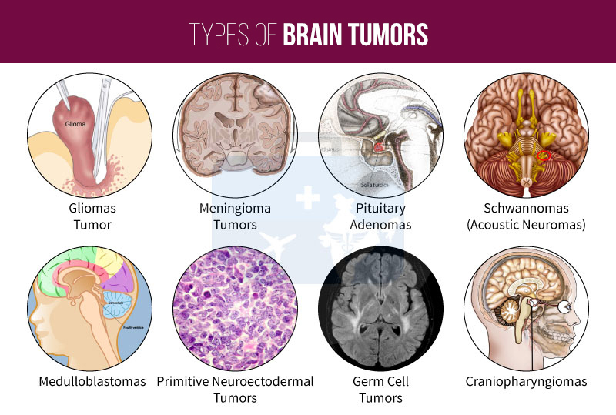
Introduction: Classification of Tumours
Many primary brain tumors are benign, whereas the secondary tumor, which is also called as the metastatic brain tumor, which is diagnosed when cancer cells spread to the brain from other organs, such as lungs etc.
Meningiomas & Pituitary adenomas constitutes the major part of Benign Tumors.
Meningiomas are the most common benign intracranial tumors, these tumors originate from the meninges, the membrane-like structures that surround the brain & spinal cord.
Pituitary adenomas are the most common tumors after gliomas & meningiomas. The large majority of Pituitary adenomas are benign and fairly slow growing.
Gliomas are the most prevalent type of adult brain tumor, accounting for 78% of Malignant Brain Tumors. They arise from the supporting cells of the brain, called the glia.

Slide 6
Literature Survey:
“Brain tumor detection using image processing”
Authors: Digvijay Reddy, Dheeraj, Kiran, Bhavana V and Krishnappa H K
Journal: “International Conference on Communication and Signal Processing, April 2018”
Methodology: provided a framework in which MRI is taken as an input and tried to extract tumor cells from the input image.
“Implementation of Image Processing for Detection of Brain Tumors”
Authors: Shrutika Santosh Hunnur, Akshata Raut, Swati Kulkarni
Journal: “International Conference on Computing Methodologies and Communication, 2017”
Methodology: aimed to detect tumor cells form MRI images received from the database.
Steps involved in this process were:
Obtaining the image, Converting into grayscale, filtering, thresholding
Morphological operations, detecting tumor
Image, shrinking, area calculation and display stage of tumor.

Slide 7
“Brain Tumor Detection and Classification using CNN & Deep Neural Network”
Authors: Chirodip Choudhury, Chandrakant Mohanty, Raghavendra Kumar & Kishore Mishra
Year: 2020
Methodology: Extracting features through CNN and then classifying using a fully connected network. The model has been built on top of Keras, supported by TensorFlow at the backend.
Accuracy: 96.08%, F-Score: 97.3%
“Design and Implementation Brain Tumor Detection using ML approach”
Author: G Hemanth, M Janardhan and L Suijihelen
Journal: “3rd International Conference on Trends in Electronics and Informatics, 2019
Methodology: This work uses automatic segmentation method thar relies upon CNN, determining small 3*3 Kernels.
Accuracy: 91%, Efficiency: 92.7%

Slide 8
“Detection and Classification of Brain Tumor in MRI using Deep CNN”
Authors: Yakub Bhanothu, Anandhanarayanan Kamalakkan & Govindaraj Rajamanickam
Journal: “International Conference on Advanced Computing & Communication Systems”
Year: 6th ICACCS, 2020
Methodology: Faster R-CNN Deep Learning Algorithm for detecting the tumor and making the area of their occurrence with Region Proposal Network (RPN).
Implementation: Proposed algorithm uses VGG – 16 architecture as a base layer for both the region proposal network and the classifier network.
Average Precision: 75.18% for Glioma, 89.45% for Meningioma
Mean Average Precision: 77.6%

Slide 9
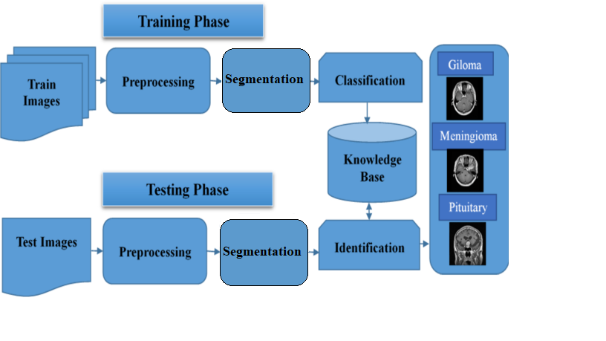
Block Diagram: The diagram depicts the flow of tasks performed, it is executed in three major phases 1) Image Pre-Processing 2) Image Segmentation 3) Classification

Slide 10
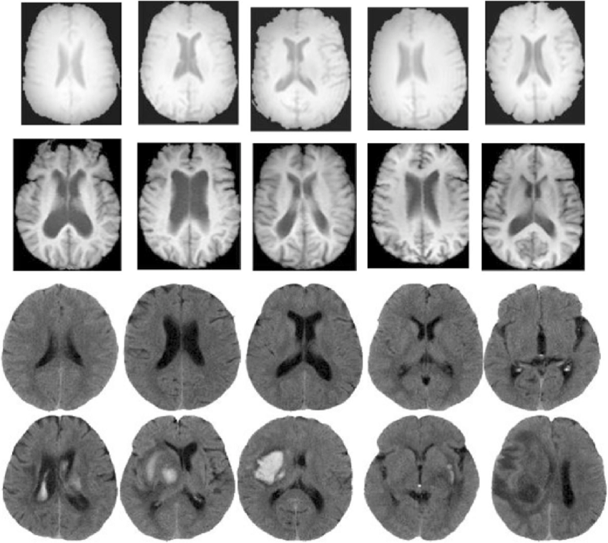
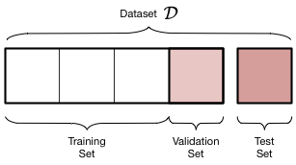
Implementation:
Brain MRI Images Dataset is collected from Kaggle Data Science Bowl
Kaggle is the world’s largest data science community with powerful tools and resources to help you achieve your data science goals.
A total of 3264 MRI images were collected
Out of which 2937 images were used to train the network
327 images are used to validate the network.
The brain tumor detection system contains:
Image Pre-Processing
Training the CNN Model
Hardware requirements and Software requirements:
Basic hardware required
Frontend: HTML, CSS ; Backend: Python3 and other libraries

Slide 11
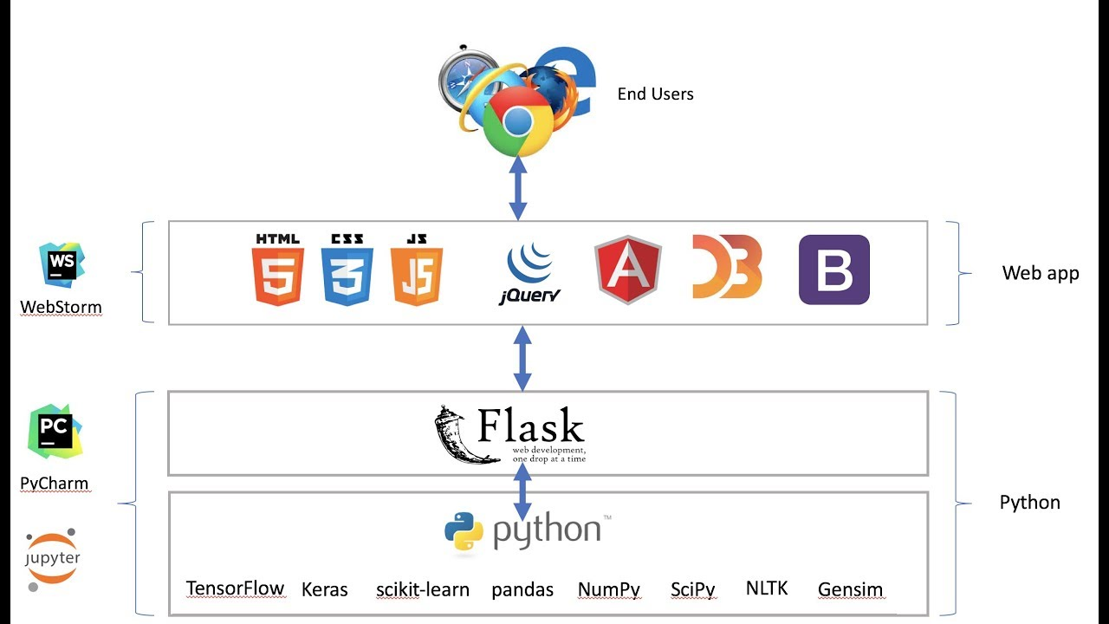
Integrating ML Model with Web:
Flask framework is used to integrate the front end web page to the backend ML Model.
Flask is an API of Python that allows us to build up web applications. Flask framework is easier to learn and it has less base code to implement a simple web Application.
The trained CNN model is saved with .h5 extension which can be later loaded into the program using Keras library.
Flask is used to render the front end HTML templates to provide a web based user interface.

Slide 12
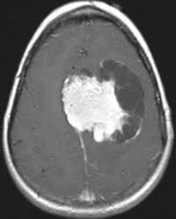
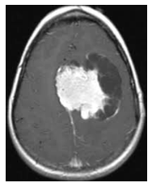
Image Pre - Processing
1) Brain scanned raw MRI Image:
A grayscale axial view of the image is considered for further processing. A grayscale image has the value for each pixel in single sample representing only an amount of light, i.e. it carries only intensity information.
2) Salt-and-Pepper noise:
Salt-and-Pepper noise is a form of noise sometimes seen on images. It is caused by sharp or sudden disturbances in the image signal or Impulse noise. This noise is removed to improve the image quality.

Slide 13
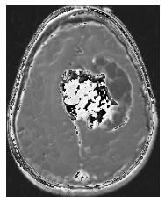
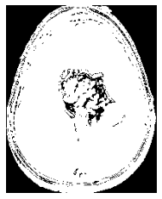
Image Pre – Processing (contd.)
3) Edge Detection
It is a technique of image processing used to identify points in a digital image with discontinuities, these points where the image brightness varies sharply are called edges(or boundaries) of the image.
4) Thresholding
It is a type of image segmentation where we change the pixels of an image to make the image easier to analyse. In thresholding colour or grayscale image is converted into a Binary Image.

Slide 14
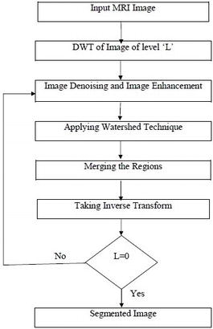
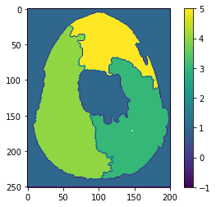
Image Segmentation
Watershed Algorithm
The watershed image segmentation method consists of three stages, namely image enhancement, image segmentation and feature extraction.
Image segmentation is a medical image processing technique for separating different objects in an image. It extracts the objects of our interest, for further processing, such as description or recognition.
5) Segmented Image

Slide 15
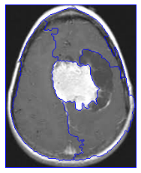
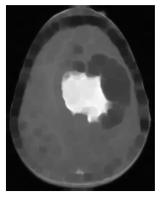
Resultant Images:
6) Mark Segmented ridges
A visualization technique is to super impose the foreground markers, background markers and segmented object boundaries in the original image.
7) Intensified Resultant image
This visualization is a resultant image with intensified tumour region where the background and foreground regions are blurred for easier recognition of the tumor along with prediction of tumour classification.

Slide 16
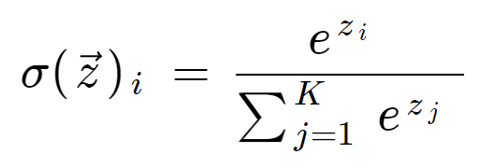
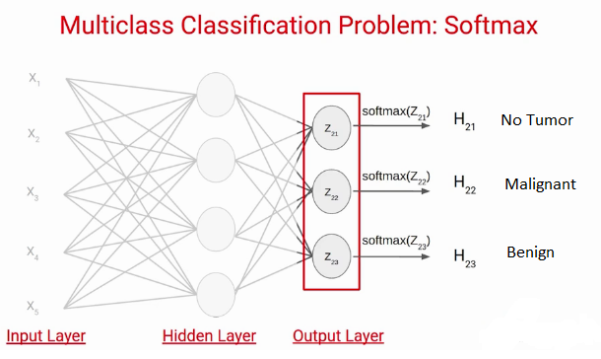
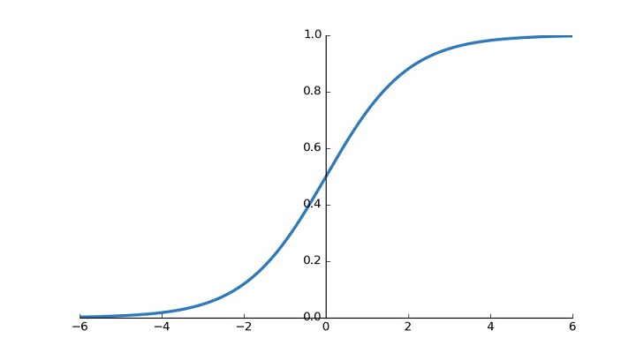
Training the CNN Model:
Further the dataset is split into train and test.
Keras EfficientNetBo model is used to train the network.
Then the train & test images are given as input to the CNN model with convolutional layers and dense and dropout layers and a SoftMax function.
We use Adams Optimizer model and Categorical Cross Entropy loss function to compile the model.
We fit the model using fit generator using 12 epochs with 2937 train samples per each epochs and 327 test samples per each epoch with a batch size of 64.
GlobalAveragePooling2D function is used to reduce the computational space.

Slide 17
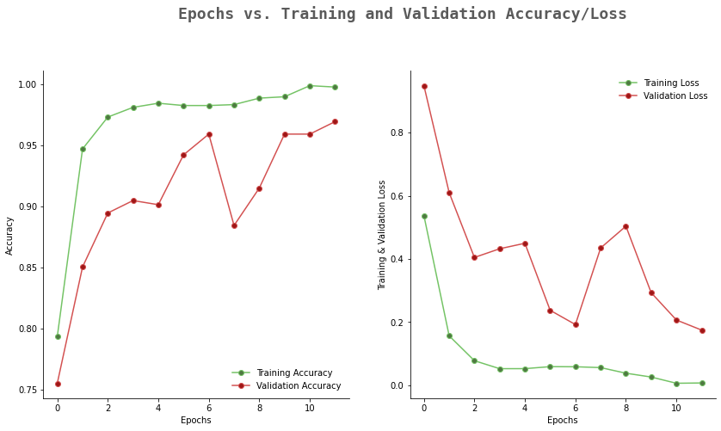
Results & Discussion
Accuracy Graph Loss Function Graph

Slide 18
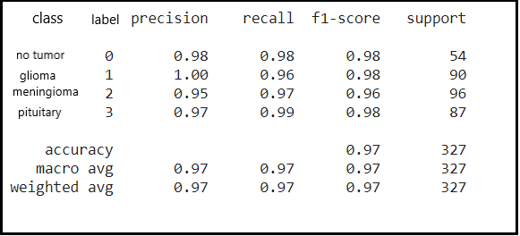
Performance Analysis
Performance Evaluation of the classifier
The Convolutional Neural Network model gave the accuracy of 97%

Slide 19
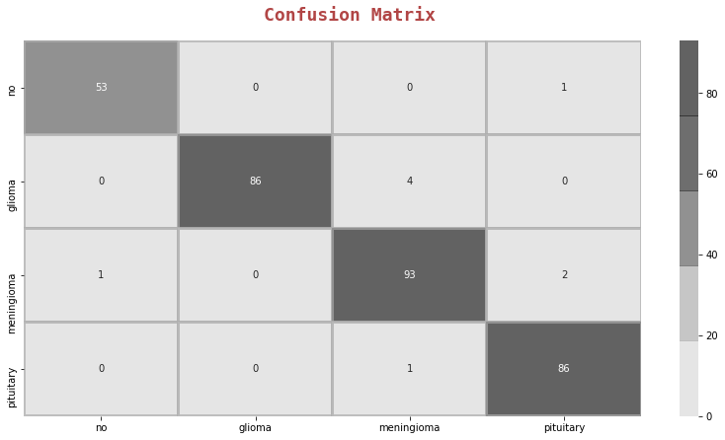
Performance Analysis (Contd.)
Confusion matrix draws a mapping on Original output vs Predicted Output, giving us an understanding over rightful and wrong predictions.

Slide 20
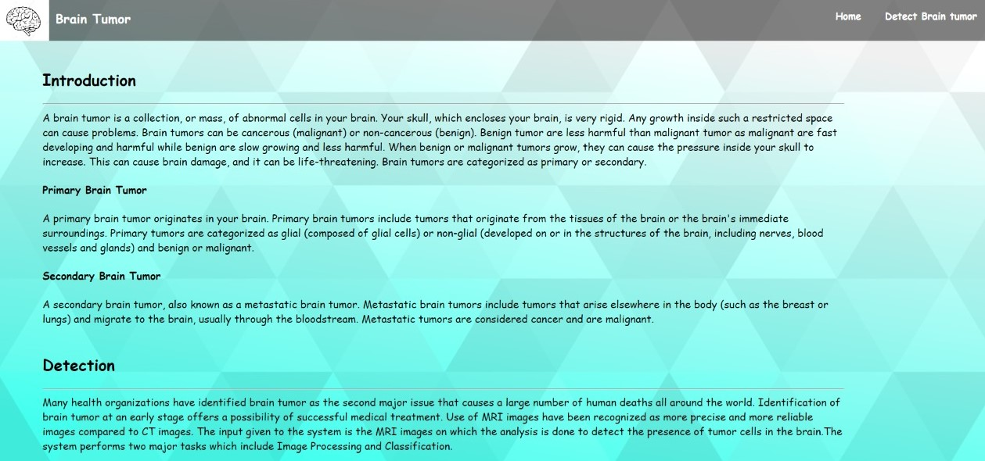
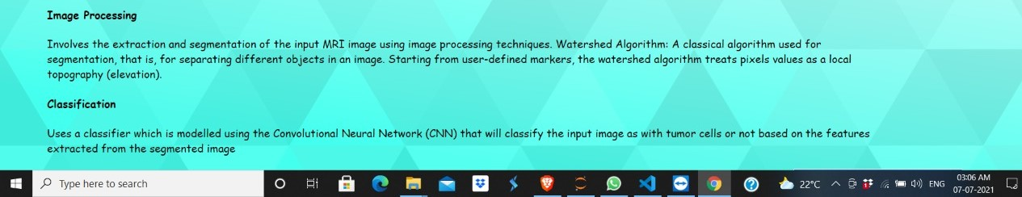
Snapshots
About Page: Introduction to types of tumors, information about steps involved in Detection

Slide 21
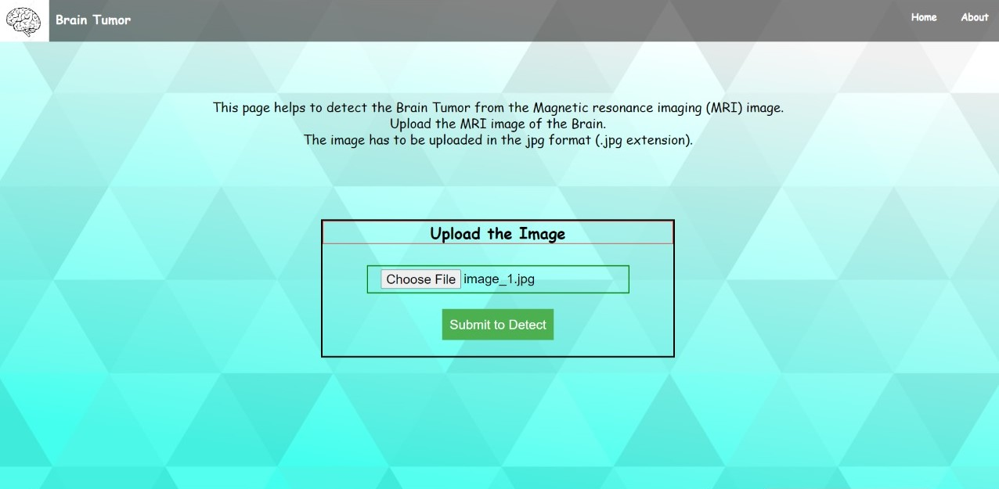
Snapshots (Contd.)
Detect the Tumor page: Has a container to submit the MRI image input

Slide 22
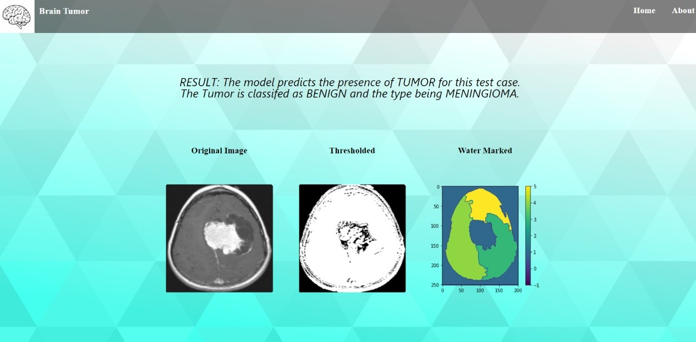
Snapshots (Contd.)
Result Page: Predicts the classification result

Slide 23
Conclusion:
Detection of brain tumor is one of the challenging problems in medical field because tumors have high diversity in appearance and there is a similarity between tumor and normal cells and it is the most crucial and arduous tasks in the terrain of medical image processing as a human-assisted manual classification can result in inaccurate prediction and diagnosis.
The CNN Model used to detect the brain tumor gave a validation accuracy of 97%.
The resulting model is very fast, robust and reliable for detecting the tumor for both Malignant Tumor as well as Benign Tumors.
Therefore the project can act as an asset in the Medical field and also it can help physicians to take effective decisions.

Slide 24
Future Scope:
The systems can be enhanced for the following functionalities to make the system more efficient:
The system contains three parts. Image processing, Brain Tumor Detection and the classification of the tumor, all these parts can be used independently.
The system considers only MRI brain images as input, further the system can he enhanced to take various imaging technologies based on Non – invasive approaches, CT scan, PET, X-Ray etc.
The system can be enhanced to mark the exact location of tumor in the brain.
The system can be enhanced to detect the stages of the tumor, if the tumor is present.
Currently, the system predicts the tumor & classifies the tumor into 3 major types of tumor, further it can be enhanced to detect all the different type of tumors available.
Also, a survival rate or life expectancy prediction can be added as a new functionality to predict the survival rate of the brain tumor affected individual.

Slide 25
Thank You

